Slide 1

PaaS and Application Networking
<name>
Notes:
Hello, my name is …, and I’m a “CE/CSA” working on Azure in our Customer Success organization.
This is a 100/200 level presentation meant to give you enough information where you can make informed decisions and understand how these components work.
Feel free to ask questions as we go.
So, with that, let’s dive in.

Slide 2
Load Balancing Options in Azure

Slide 3



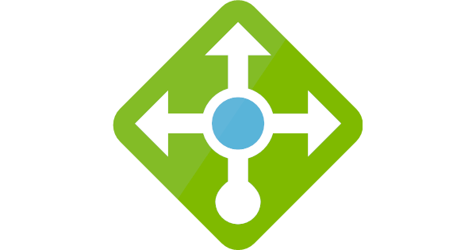






Load balancing in Azure
Path-based load balancing, performance acceleration with and fast cross-region failover for HTTP(S) apps.
Application Gateway
Path-based load balancing and VNET integration for in-region web application deployment.
Front Door
HTTP/S
Traffic Manager
Migrate to the cloud with cross-region and on-premises resource for non-HTTP(s) apps.
Load Balancer (Public/Internal)
Inbound and outbound load balancing with low latency, high throughput for all TCP and UDP applications.
Non-HTTP/S
Global
Region / Zone
Global
Regional
Route to your closest available service region in Azure or your on-premises DC. Load balance across your application scale-units or deployments or endpoints.
Route across zones and into your VNET. Private IP space routing and between your resources to build your regional application. Load balance across your VMs or containers within a region behind a VNET.
Notes:
The term load balancing refers to the distribution of workloads across multiple computing resources. Load balancing aims to optimize resource use, maximize throughput, minimize response time, and avoid overloading any single resource. It can also improve availability by sharing a workload across redundant computing resources.
Azure provides various load balancing services that you can use to distribute your workloads across multiple computing resources - Application Gateway, Front Door, Load Balancer, and Traffic Manager.
Global versus regional
Global load-balancing services distribute traffic across regional backends, clouds, or hybrid on-premises services. These services route end-user traffic to the closest available backend. They also react to changes in service reliability or performance, in order to maximize availability and performance. You can think of them as systems that load balance between application stamps, endpoints, or scale-units hosted across different regions/geographies.
Regional load-balancing services distribute traffic within virtual networks across virtual machines (VMs) or zonal and zone-redundant service endpoints within a region. You can think of them as systems that load balance between VMs, containers, or clusters within a region in a virtual network.
Azure load balancing services
Here are the main load-balancing services currently available in Azure:
Front Door is an application delivery network that provides global load balancing and site acceleration service for web applications. It offers Layer 7 capabilities for your application like SSL offload, path-based routing, fast failover, caching, etc. to improve performance and high-availability of your applications.
Traffic Manager is a DNS-based traffic load balancer that enables you to distribute traffic optimally to services across global Azure regions, while providing high availability and responsiveness. Because Traffic Manager is a DNS-based load-balancing service, it load balances only at the domain level. For that reason, it can't fail over as quickly as Front Door, because of common challenges around DNS caching and systems not honoring DNS TTLs.
Application Gateway provides application delivery controller (ADC) as a service, offering various Layer 7 load-balancing capabilities. Use it to optimize web farm productivity by offloading CPU-intensive SSL termination to the gateway.
Azure Load Balancer is a high-performance, ultra low-latency Layer 4 load-balancing service (inbound and outbound) for all UDP and TCP protocols. It is built to handle millions of requests per second while ensuring your solution is highly available. Azure Load Balancer is zone-redundant, ensuring high availability across Availability Zones.
Decision tree for Load Balancing in Azure
https://docs.microsoft.com/en-us/azure/architecture/guide/technology-choices/load-balancing-overview#decision-tree-for-load-balancing-in-azure
https://docs.microsoft.com/en-us/azure/architecture/guide/technology-choices/load-balancing-overview

Slide 4
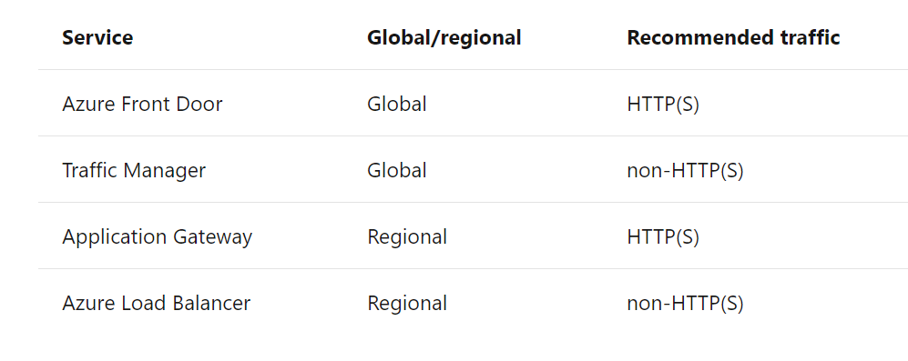
Notes:
HTTP(S) versus non-HTTP(S)
HTTP(S) load-balancing services are Layer 7 load balancers that only accept HTTP(S) traffic. They are intended for web applications or other HTTP(S) endpoints. They include features such as SSL offload, web application firewall, path-based load balancing, and session affinity.
Non-HTTP/S load-balancing services can handle non-HTTP(S) traffic and are recommended for non-web workloads.

Slide 5

Deliver | Front Door Service
Scalable and secure entry point for fast delivery of your global applications

Slide 6



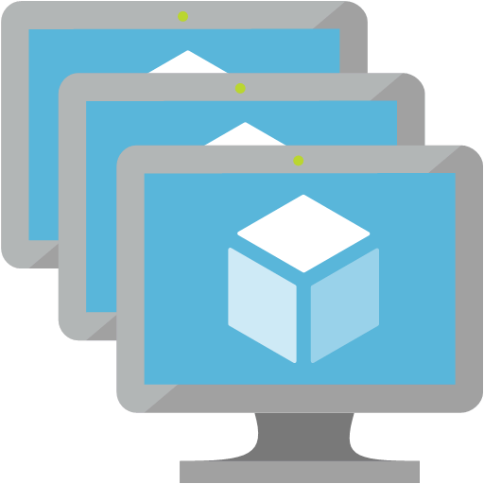

Azure Front Door Service
User
Application acceleration at Microsoft’s edge
Integrated with App Services, Cloud Services and Storage
Global HTTP load balancing with instant failover
Global DDoS protection and application layer security
Massive SSL offload
Integrated static content caching
Central application traffic dashboard
Azure Front Door Service
HTTP(S)
DDoS and application layer security
/*
Path based traffic load balancing
Static content caching
64 global edge POPs
Active global traffic routing
Global Private WAN
probe
probe
Connection pooling
Azure Region 1
Azure Region 2
Notes:
Azure Front Door Service overview:
Azure Front Door Service enables you to define, manage, and monitor the global routing for your web traffic by optimizing for best performance and instant global failover for high availability. With Front Door, you can transform your global (multi-region) consumer and enterprise applications into robust, high-performance personalized modern applications, APIs, and content that reach a global audience with Azure.
Front Door works at Layer 7 or HTTP/HTTPS layer and uses anycast protocol with split TCP and Microsoft's global network for improving global connectivity. So, per your routing method selection in the configuration, you can ensure that Front Door is routing your client requests to the fastest and most available application backend. An application backend is any Internet-facing service hosted inside or outside of Azure.
Front Door provides a range of traffic-routing methods and backend health monitoring options to suit different application needs and automatic failover models. Similar to Traffic Manager, Front Door is resilient to failures, including the failure of an entire Azure region.
The following features are included with Front Door:
Accelerate application performance
Increase application availability with smart health probes
URL-based routing
Multiple-site hosting
Session affinity
Secure Sockets Layer (SSL) termination
Custom domains and certificate management
Application layer security
URL redirection
URL rewrite
Protocol support - IPv6 and HTTP/2 traffic
Reference:
Azure Front Door Service
https://azure.microsoft.com/en-us/services/frontdoor/

Slide 7
Azure Front Door Service
Global HTTP/S Load Balancing
Leverage global layer 7 load balancing with massive SSL offload and single application domain management
URL-based routing with URL rewrite
Configure easy routing for your microservices with path-based routing and custom forwarding path
Custom domains and certificates
Onboard your custom domain and enable HTTPS through either Front Door certificates or upload your custom SSL certificates
Multiple options for traffic routing
Priority routing for Active/Standby topologies. Session affinity for sending subsequent traffic to same backends.
Network DDoS protection
Built in with platform. Block attacks at Azure edge, only allow http(s) workloads to reach apps behind Front Door
Access Control and Rate Limiting
Configure custom rules to control access based on list of IP addresses, matching http(s) request parameters or client’s country code.
Rate limiting
Configure limit on number of web requests allowed by a client IP in a one-minute duration
IPv6 and HTTP/2
Natively support for end-to-end IPv6 connectivity. Front Door also supports HTTP/2 protocol.
Notes:
References:
Azure Front Door Service
https://azure.microsoft.com/en-us/services/frontdoor/

Slide 8

Deliver | Traffic Manager
Route incoming traffic for high performance and availability

Slide 9
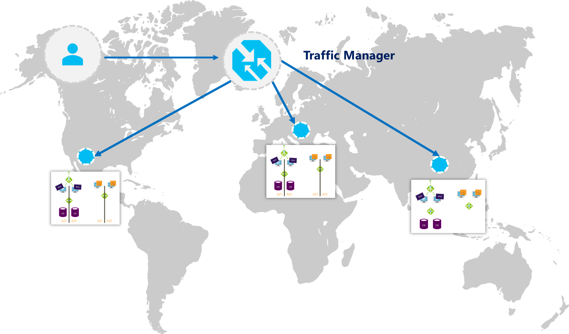
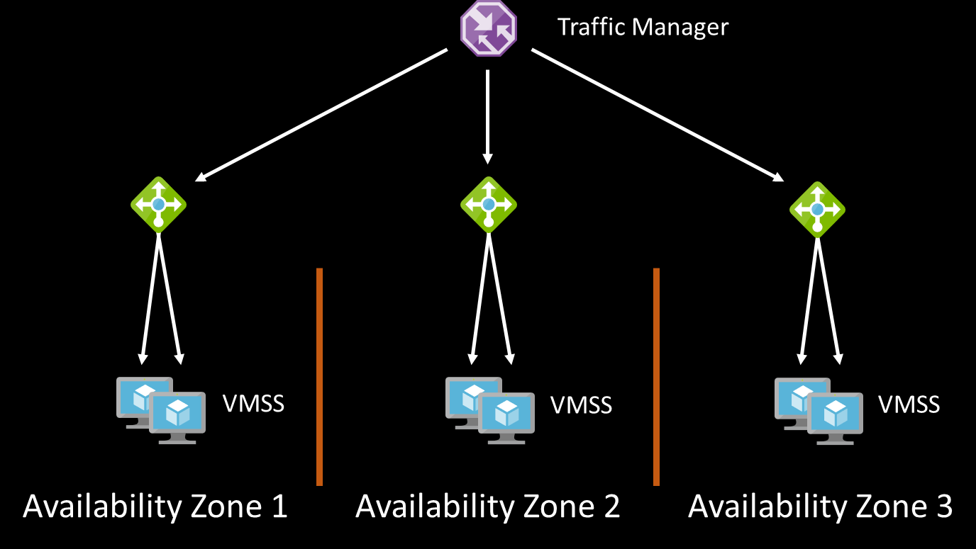
Traffic Manager
DNS request routing
Easy Onboarding
Multiple Routing Methods
Endpoint monitoring
High resiliency
Real User Measurement & Traffic View
Routing based on profiles
Priority
Weighted
Performance
Geographic
MultiValue
Subnet
Diagnostics and Probes
Traffic View visualization: Understand the volume of traffic generated by your users and the latency experienced by them, at a per region level
TCP & HTTP health probes
VMSS per Zone
TM profile for High Availability
Zonal VIP / VMSS
DNS name for cross-zone VMSS
Notes:
Azure Traffic Manager overview:
Azure Traffic Manager is a DNS-based traffic load balancer that enables you to distribute traffic optimally to services across global Azure regions, while providing high availability and responsiveness.
Traffic Manager uses DNS to direct client requests to the most appropriate service endpoint based on a traffic-routing method and the health of the endpoints. An endpoint is any Internet-facing service hosted inside or outside of Azure. Traffic Manager provides a range of traffic-routing methods and endpoint monitoring options to suit different application needs and automatic failover models. Traffic Manager is resilient to failure, including the failure of an entire Azure region.
Traffic Manager offers following features:
Increase application availability
Traffic Manager delivers high availability for your critical applications by monitoring your endpoints and providing automatic failover when an endpoint goes down.
Improve application performance
Azure allows you to run cloud services or websites in datacenters located around the world. Traffic Manager improves application responsiveness by directing traffic to the endpoint with the lowest network latency for the client.
Perform service maintenance without downtime
You can perform planned maintenance operations on your applications without downtime. Traffic Manager can direct traffic to alternative endpoints while the maintenance is in progress.
Combine hybrid applications
Traffic Manager supports external, non-Azure endpoints enabling it to be used with hybrid cloud and on-premises deployments, including the "burst-to-cloud," "migrate-to-cloud," and "failover-to-cloud" scenarios.
Distribute traffic for complex deployments
Using nested Traffic Manager profiles, multiple traffic-routing methods can be combined to create sophisticated and flexible rules to scale to the needs of larger, more complex deployments.
References:
What is Traffic Manager?
https://docs.microsoft.com/en-us/azure/traffic-manager/traffic-manager-overview
Traffic Manager routing methods
https://docs.microsoft.com/en-us/azure/traffic-manager/traffic-manager-routing-methods

Slide 10
Traffic Manager
Traffic Manager is:
DNS-based traffic routing service
Active health monitoring and automatic failover
With Traffic Manager, you can:
Route incoming traffic across multiple Azure services to provide your applications high performance
Automatically fail over between deployments, for high availability
Manage traffic across cloud and on-premises endpoints for hybrid applications and cloud migration
Easily add/remove deployments from active use, allowing seamless upgrades
www.contoso.com
CNAME
contoso.trafficmanager.net
Traffic routing
Endpoint monitoring
Cloud service
Web app
Non-Azure
endpoints
Notes:
Only a single traffic routing method can be selected in a profile
Routing methods can be changed at any time
Changes go into effect within one minute, with no downtime

Slide 11
Traffic Manager – Nested Profiles
Manage user traffic to your applications with high flexibility
Example: Cross-region failover within a Geo, plus in-region flighting
Level 1: Route to user’s nearest Geo (US, EU, ASIA)
Level 2: Route to nearest region, with cross-region failover within the Geo
Level 3: Within the region, divert 1% for flighting
West US
East US
Europe North
Europe West
Regions

Slide 12
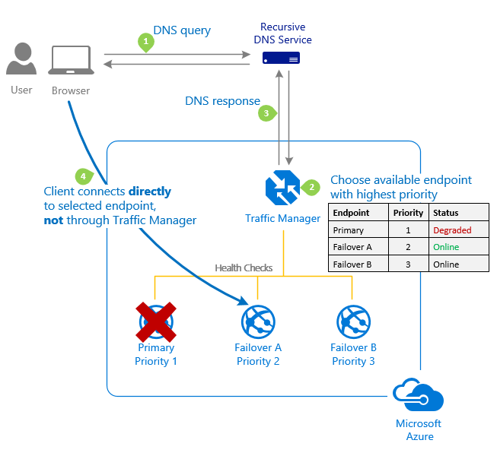
Priority traffic profile
By default, Traffic Manager sends all traffic to the primary (highest-priority) endpoint
If the primary endpoint is not available, Traffic Manager routes the traffic to the second endpoint
If both the primary and secondary endpoints are not available, the traffic goes to the third, and so on
Priority property is a value between 1 and 1000. Lower values represent a higher priority

Slide 13
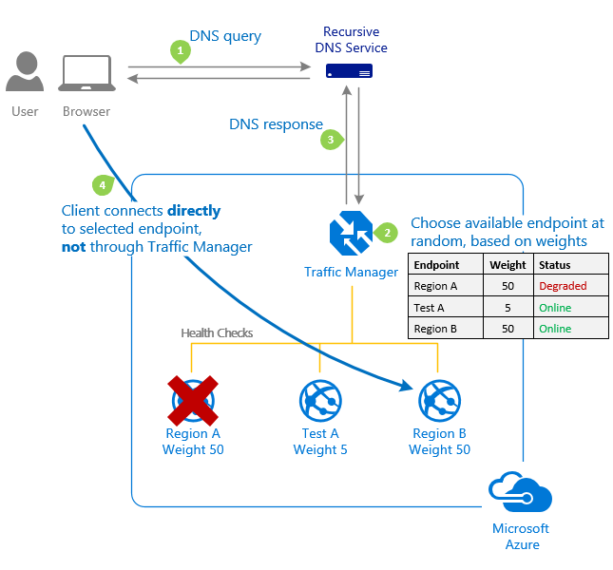
Weighted traffic profile
Weights are defined from 1 to 1000
Gradual application upgrade: Allocate a percentage of traffic to route to a new endpoint, and gradually increase the traffic over time to 100%
Application migration to Azure: Create a profile with both Azure and external endpoints. Adjust the weight of the endpoints to prefer the new endpoint
Cloud bursting for additional capacity: Quickly expand an on-premises deployment into the cloud by putting it behind a Traffic Manager profile. When you need extra capacity in the cloud, you can add or enable more endpoints and specify what portion of traffic goes to each endpoint

Slide 14
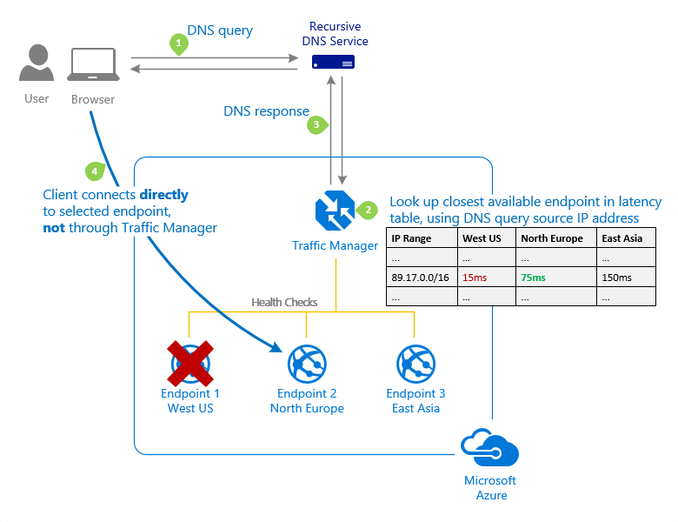
Performance traffic profile
The 'Performance' traffic-routing method determines the closest endpoint by measuring network latency
Traffic Manager maintains an Internet Latency Table to track the round-trip time between IP address ranges and each Azure datacenter
Traffic Manager looks up the source IP address of the incoming DNS request in the Internet Latency Table. Traffic Manager chooses an available endpoint in the Azure datacenter that has the lowest latency for that IP address range, then returns that endpoint in the DNS response
The IP address used to determine the 'closest' endpoint is not the client's IP address, but it is the IP address of the recursive DNS service

Slide 15

Deliver | Application Gateway
Platform-managed, scalable, and highly available application delivery controller as a service

Slide 16
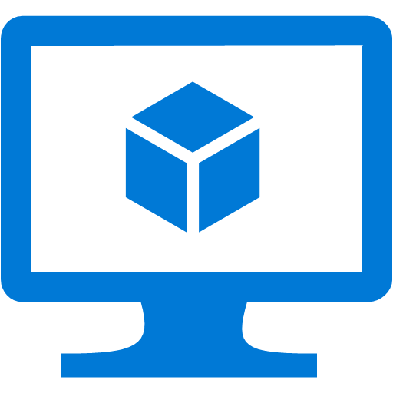
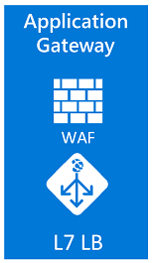
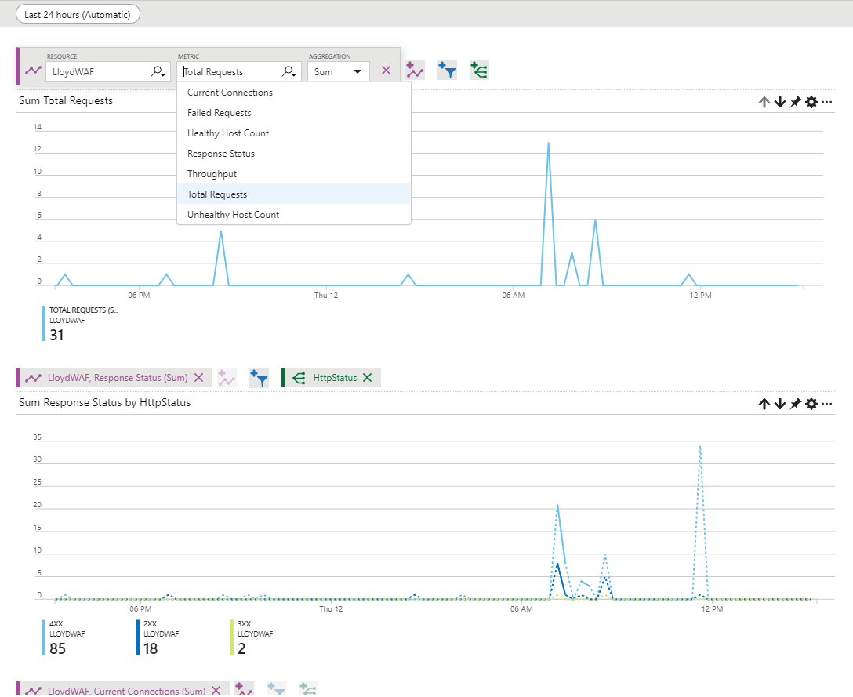
Application Gateway
Layer 7, per request routing
HTTP round robin
Cookie based session affinity
Multi-site hosting
URL based routing
Application layer security
SSL termination
SSL Policy (protocol version and cipher)
End to end SSL
Web Application Firewall (OWASP)
Diagnostics and Probes
Access, performance, backend health logs
Monitor metrics & alerts: Total request, Failed requests, Healthy/Unhealthy host counts, Response status distribution (2xx, 3xx, 4xx, 5xx), Throughput
Custom health probes (HTTP, HTTPS)
fabrikam.com
Support Web Apps
Redirection
Videos
contoso.com
fabrikam.com
Images
contoso.com/video/*
contoso.com/images/*
Notes:
Application Gateway overview:
Azure Application Gateway is a web traffic load balancer that enables you to manage traffic to your web applications. Traditional load balancers operate at the transport layer (OSI layer 4 - TCP and UDP) and route traffic based on source IP address and port, to a destination IP address and port.
With Application Gateway, you can make routing decisions based on additional attributes of an HTTP request, such as URI path or host headers. For example, you can route traffic based on the incoming URL. So if an “/images” is in the incoming URL, you can route traffic to a specific set of servers (known as a pool) configured for images. If a “/video” is in the URL, that traffic is routed to another pool that's optimized for videos. This type of routing is known as application layer (OSI layer 7) load balancing. Azure Application Gateway can do URL-based routing and more.
Azure Application Gateway is platform managed, dedicated deployment. Azure takes care of availability, patching, management of these deployments for you.
Application Gateway like Azure Load Balancer is regional in scope but has more advanced connectivity options. You are not limited to scale sets or VNets.
Application Gateway can be deployed as both Public facing or Internal Load Balancer only. More importantly, you can use Application Gateway with both endpoints exposed at the same time to function as both internal and external layer 7 Azure Datacenter.
The following features are included with Azure Application Gateway:
Feature v1 SKU v2 SKU
Autoscaling ✓
Zone redundancy ✓
Static VIP ✓
Azure Kubernetes Service (AKS) Ingress controller ✓
Azure Key Vault integration ✓
Rewrite HTTP(S) headers ✓
URL-based routing ✓ ✓
Multiple-site hosting ✓ ✓
Traffic redirection ✓ ✓
Web application firewall (WAF) ✓ ✓
Secure Sockets Layer (SSL) termination ✓ ✓
End-to-end SSL encryption ✓ ✓
Session affinity ✓ ✓
Custom error pages ✓ ✓
WebSocket support ✓ ✓
HTTP/2 support ✓ ✓
Connection draining ✓ ✓
Basically an Azure Application Gateway is an SSL terminating reverse proxy which offers many functionalities. It is difficult to list down all the capabilities in one chart but here is an attempt. We offer layer 7 routing capabilities such as:
true round robin load distribution on per http request basis
Ability to pin a user session to the same VM even when originating traffic is behind CDN or proxy
Ability to host multiple sites behinds the same Application Gateway
And many more
References:
What is Azure Application Gateway?
https://docs.microsoft.com/en-us/azure/application-gateway/overview
How an application gateway works
https://docs.microsoft.com/en-us/azure/application-gateway/how-application-gateway-works
Feature comparison between v1 SKU and v2 SKU
https://docs.microsoft.com/en-us/azure/application-gateway/application-gateway-autoscaling-zone-redundant#feature-comparison-between-v1-sku-and-v2-sku

Slide 17
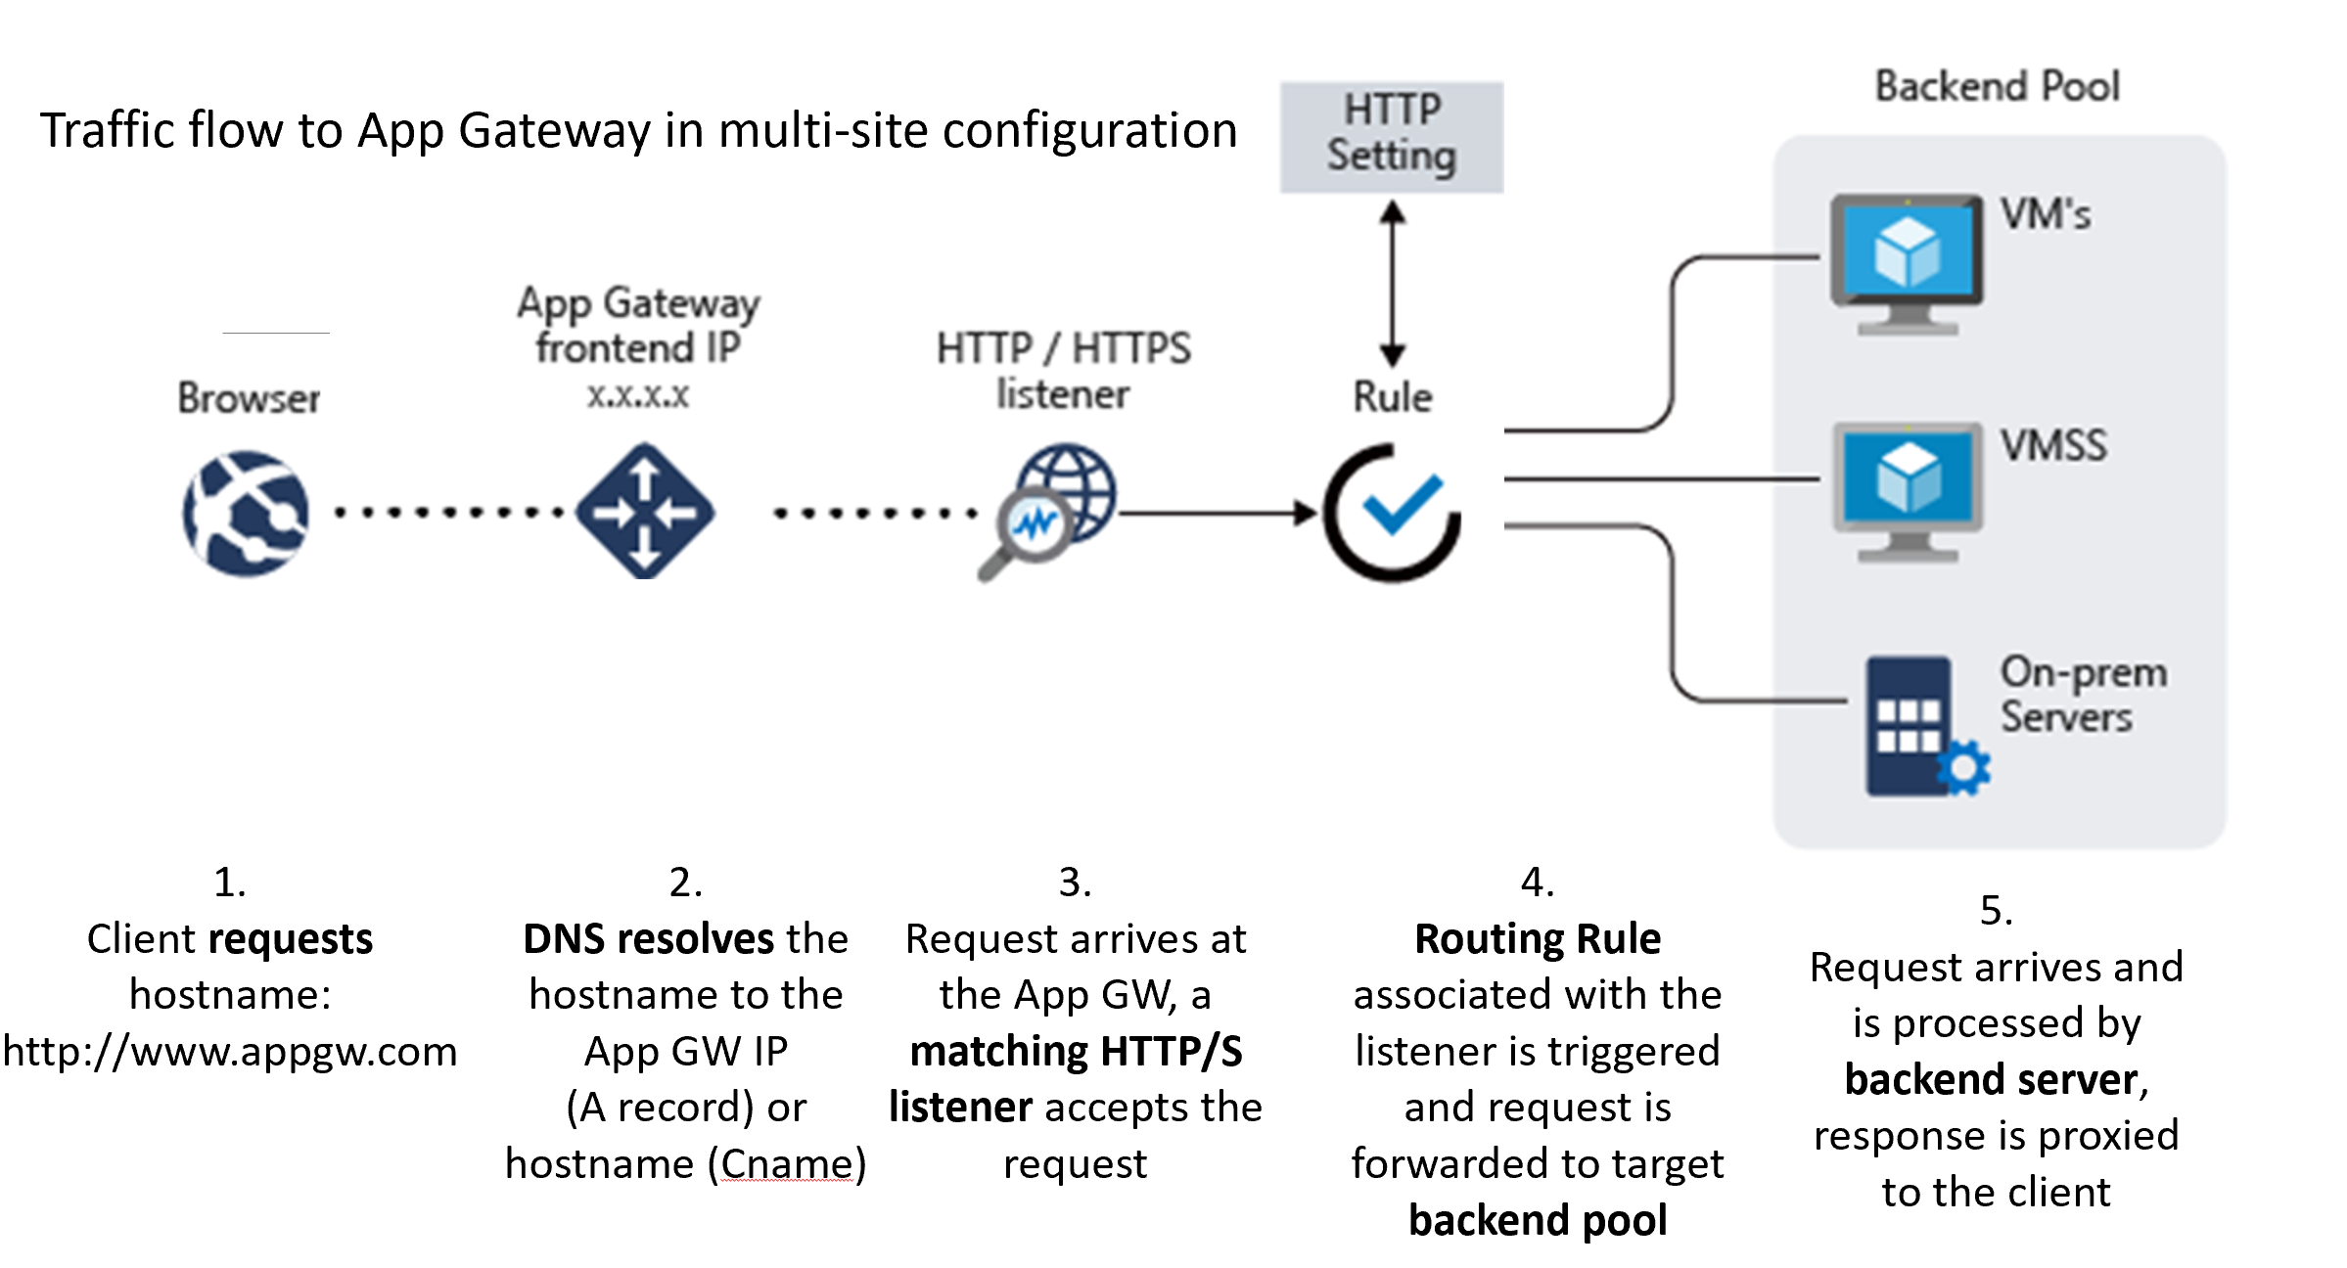

Slide 18
Protect | Web Application Firewall
Centralized protection of your web applications from common exploits and vulnerabilities
Centralized protection for your web applications that are globally delivered using Azure Front Door

Slide 19

Web Application Firewall (WAF) using Application Gateway
Protect web sites from common application vulnerabilities
Application Gateway & WAF
Site 1
Platform managed WAF
Built in high availability and scalability
Protect application
SQL Injection, XSS, protocol violation & others
Near real time monitoring
Azure Monitor & Azure Security Center
WAF managed rules
OWASP Core Rule Set 3.0 and 2.2.9 native support
WAF Configurability
Control request body evaluation
Control request and file sizes
WAF Exclusion List
Exclude request attributes from WAF evaluation
Apply to request header/cookies/parameters
×
XSS attack
Valid request
WAF
Valid request
Site 2
×
Valid request
SQL Injection
L7 LB
Protect your app against prevalent X- Site Scripting and SQL Injection attacks
Blocks threats based on Top 10 OWASP signatures
Integrated with Azure Security Center
Real-time logging with Azure Monitor
Platform managed, scalable and highly available
Notes:
Web application firewall for Azure Application Gateway overview:
Azure Application Gateway offers a web application firewall (WAF) that provides centralized protection of your web applications from common exploits and vulnerabilities. Web applications are increasingly targeted by malicious attacks that exploit commonly known vulnerabilities. SQL injection and cross-site scripting are among the most common attacks.
Preventing such attacks in application code is challenging. It can require rigorous maintenance, patching, and monitoring at multiple layers of the application topology. A centralized web application firewall helps make security management much simpler. A WAF also gives application administrators better assurance of protection against threats and intrusions.
A WAF solution can react to a security threat faster by centrally patching a known vulnerability, instead of securing each individual web application. Existing application gateways can easily be converted into fire wall-enabled application gateways.
The Application Gateway WAF is based on Core Rule Set (CRS) 3.0 or 2.2.9 from the Open Web Application Security Project (OWASP). The WAF automatically updates to include protection against new vulnerabilities, with no additional configuration needed.
Application Gateway operates as an application delivery controller (ADC). It offers Secure Sockets Layer (SSL) termination, cookie-based session affinity, round-robin load distribution, content-based routing, ability to host multiple websites, and security enhancements. Application Gateway security enhancements include SSL policy management and end-to-end SSL support. Application security is strengthened by WAF integration into Application Gateway. The combination protects your web applications against common vulnerabilities. And it provides an easy-to-configure central location to manage.
Benefits
This section describes the core benefits that Application Gateway and its WAF provide.
Protection
Protect your web applications from web vulnerabilities and attacks without modification to back-end code.
Protect multiple web applications at the same time. An instance of Application Gateway can host of up to 100 websites that are protected by a web application firewall.
Monitoring
Monitor attacks against your web applications by using a real-time WAF log. The log is integrated with Azure Monitorto track WAF alerts and easily monitor trends.
The Application Gateway WAF is integrated with Azure Security Center. Security Center provides a central view of the security state of all your Azure resources.
Customization
You can customize WAF rules and rule groups to suit your application requirements and eliminate false positives.
References:
Web application firewall (WAF)
https://docs.microsoft.com/en-us/azure/application-gateway/waf-overview
Web application firewall request size limits and exclusion lists
https://docs.microsoft.com/en-us/azure/application-gateway/application-gateway-waf-configuration
Custom rules for Web Application Firewall v2
https://docs.microsoft.com/en-us/azure/application-gateway/custom-waf-rules-overview

Slide 20
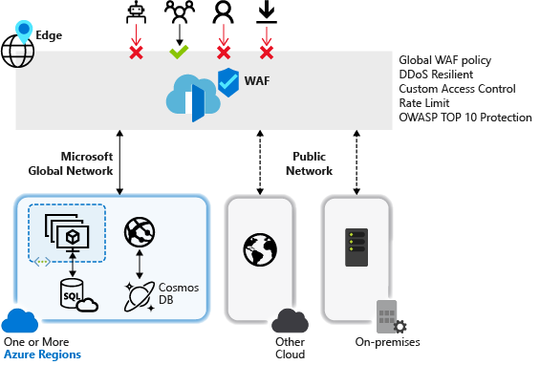
Web Application Firewall (WAF) using Azure Front Door
Centralized protection for your web applications that are globally delivered
WAF Modes:
Detection and Prevention
WAF Actions:
Allow, Block, Log, and Redirect
WAF rules:
IP allow list and block list
Geographic based access control
HTTP parameters-based access control
Request method-based access control
Size constraint
Rate limiting rules
Notes:
Web application firewall for Azure Front Door overview:
Azure web application firewall (WAF) provides centralized protection for your web applications that are globally delivered using Azure Front Door. It is designed and operated to defend your web services against common exploits and vulnerabilities and keep your service highly available for your users in addition to helping you meet compliance requirements.
Web applications are increasingly the targets of malicious attacks such as denial of service floods, SQL injection attacks, and cross-site scripting attacks. These malicious attacks may cause service outage and data loss, pose a significant threat to web application owners.
Preventing such attacks in application code can be challenging and may require rigorous maintenance, patching and monitoring at multiple layers of the application topology. A centralized web application firewall helps make security management much simpler and gives better assurance to application administrators against threats or intrusions. In addition, a WAF solution can react to a security threat faster by patching a known vulnerability at a central location, instead of securing each of individual web applications.
WAF for Front Door is a global and centralized solution. It is deployed on Azure network edge locations around the globe and every incoming request for a WAF enabled web application delivered by Front Door is inspected at the network edge.
This allows WAF to prevent malicious attacks close to the attack sources, before they enter your virtual network and offers global protection at scale without sacrificing performance. A WAF policy can be easily linked to any Front Door profile in your subscription and new rules can be deployed within minutes, allowing you to respond quickly to changing threat patterns.
References:
Web application firewall (WAF)
https://docs.microsoft.com/en-us/azure/frontdoor/waf-overview
Custom rules for web application firewall with Azure Front Door
https://docs.microsoft.com/en-us/azure/frontdoor/waf-front-door-custom-rules

Slide 21

Deliver | Load Balancer
Deliver high availability and network performance to your applications

Slide 22
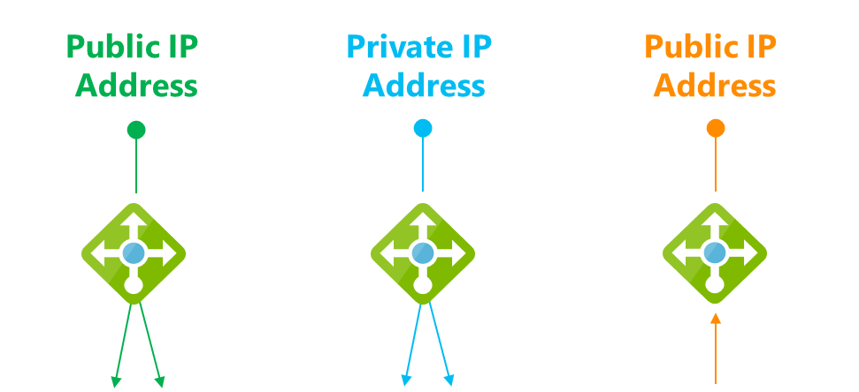

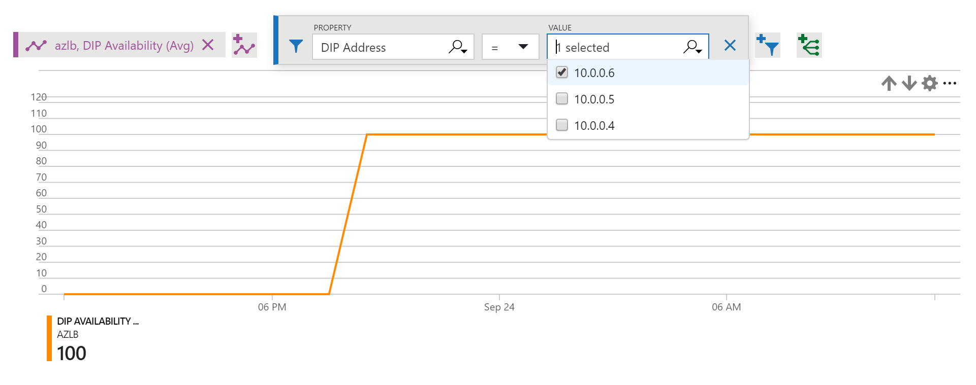
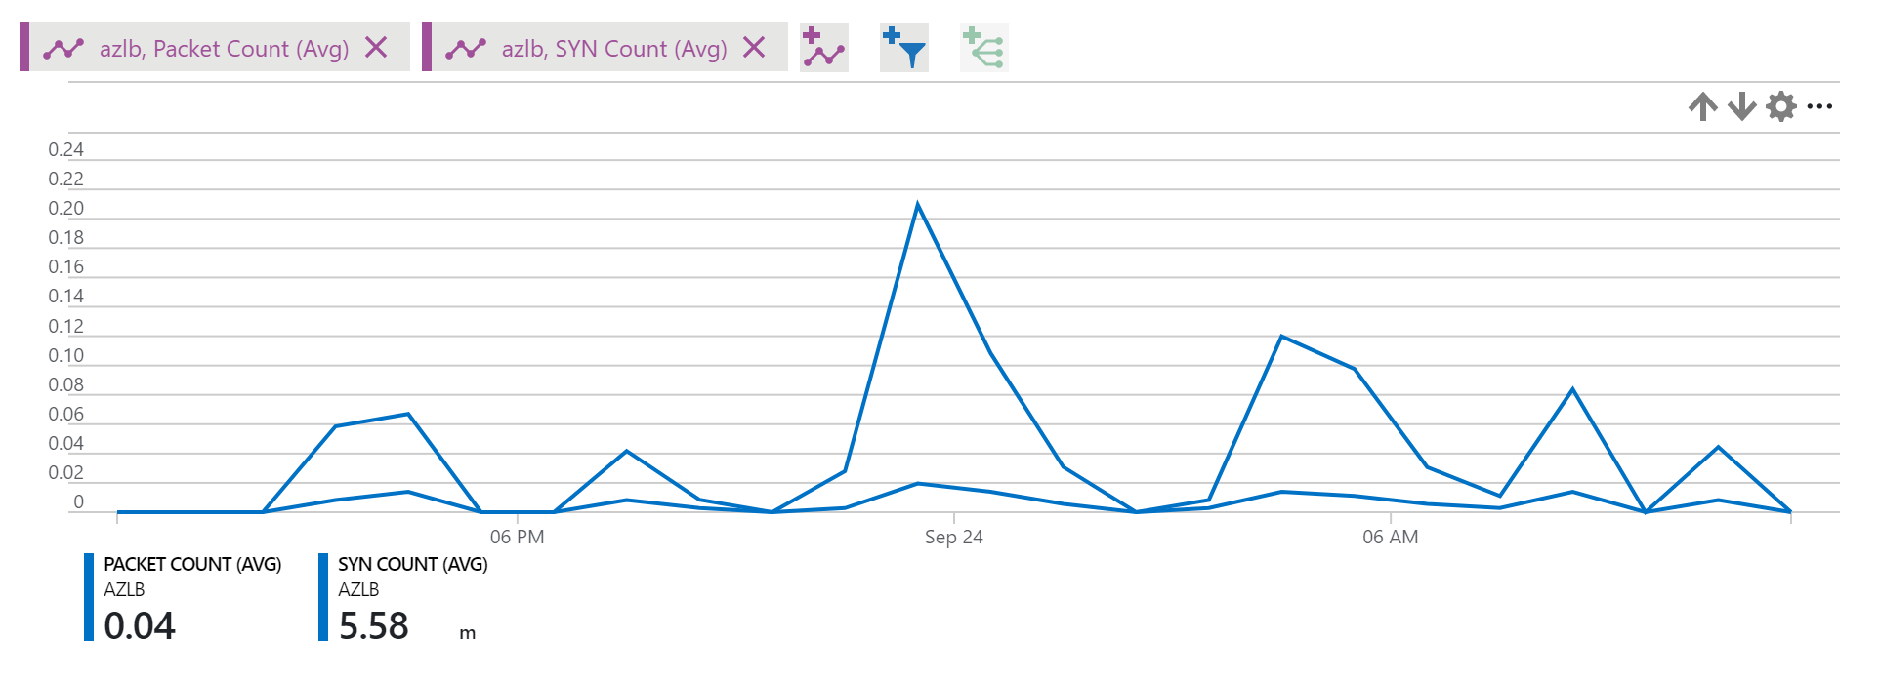
Load Balancer
Layer 4, per flow
All TCP & UDP applications
Inbound & outbound
Flow-based Load Balancing with Health Probing
Inbound NAT rules (port forwarding)
Availability Zones support
HA Ports load balancing
2 SKUs: Standard & Basic
High performance
Part of the Azure SDN stack, not a VM
Low latency
High throughput
Outbound bandwidth only limited by VM in pool
Diagnostics and Probes
Multi-dimensional metrics and alerts in Azure Monitor
TCP & HTTP health probes, Data path health
3 Key Scenarios
Notes:
Azure Load Balancer overview:
With Azure Load Balancer, you can scale your applications and create high availability for your services. Load Balancer supports inbound and outbound scenarios, provides low latency and high throughput, and scales up to millions of flows for all TCP and UDP applications.
Load Balancer distributes new inbound flows that arrive on the Load Balancer's frontend to backend pool instances, according to rules and health probes.
Additionally, a public Load Balancer can provide outbound connections for virtual machines (VMs) inside your virtual network by translating their private IP addresses to public IP addresses.
Azure Load Balancer is available in two SKUs: Basic and Standard. There are differences in scale, features, and pricing. Any scenario that's possible with Basic Load Balancer can also be created with Standard Load Balancer, although the approaches might differ slightly. As you learn about Load Balancer, it is important to familiarize yourself with the fundamentals and SKU-specific differences.
Why use Load Balancer?
You can use Azure Load Balancer to:
Load-balance incoming internet traffic to your VMs. This configuration is known as a Public Load Balancer.
Load-balance traffic across VMs inside a virtual network. You can also reach a Load Balancer front end from an on-premises network in a hybrid scenario. Both scenarios use a configuration that is known as an Internal Load Balancer.
Port forward traffic to a specific port on specific VMs with inbound network address translation (NAT) rules.
Provide outbound connectivity for VMs inside your virtual network by using a public Load Balancer.
References:
What is Azure Load Balancer?
https://docs.microsoft.com/en-us/azure/load-balancer/load-balancer-overview

Slide 23



Combine them as needed
DNS
Traffic
Manager
Load Balancer
Application Gateway / WAF
Load Balancer
DB
DB
DB
DB
DB
DB
DB
DB
REGION A
REGION B
Scalable
Redundant
+ AZ’s
Scalable
Redundant
+ Per Request
+ Security
Scalable
Redundant
Per Request
Security
+ Cross-region
Notes:
Let’s dive a little deeper.
You can use Azure Load Balancer for your scenarios and create scalability and redundancy
You could also choose to use Application Gateway and WAF to add additional layer 7 processing and protection
And lastly, you can scale out across multiple regions using DNS load balancing with Traffic Manager
We have solutions for all your load balancing needs, whether that is
layer 4 TCP and UDP,
layer 7 HTTP, HTTPS,
or global DNS load balancing

Slide 24

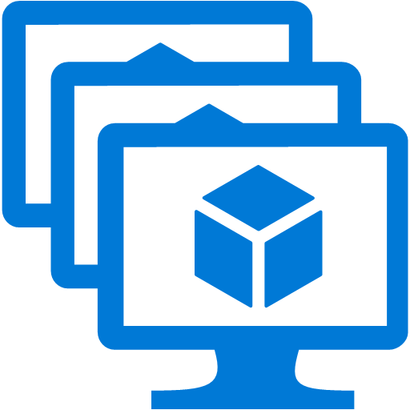
Standard LB for entire VNet
Any VM in a backend pool (no Availability Set boundary)
Standalone VMs without Availability Sets
Standalone VMs with Availability Sets
Virtual machine scale sets with up to 1000 instances
Zonal and Cross-zone VMSS (single IP)
Multiple standalone VM, Availability Sets, VMSS
Blending VMs and virtual machine scale sets
Secure by default
Use NSG to explicit whitelist traffic you want to permit
Load Balancer Standard
VNet
VM scale set
VM scale set
VM scale set
Zone 1
Zone 2
Zone 3
Load Balancer Standard
VNet
VM Scale Set
Zone 1
Zone 2
Zone 3
Notes:
Azure Standard Load Balancer overview:
Azure Load Balancer allows you to scale your applications and create high availability for your services. Load Balancer can be used for inbound as well as outbound scenarios and provides low latency, high throughput, and scales up to millions of flows for all TCP and UDP applications.
What is Standard Load Balancer?
Standard Load Balancer is a new Load Balancer product for all TCP and UDP applications with an expanded and more granular feature set over Basic Load Balancer. While there are many similarities, it is important to familiarize yourself with the differences between the Basic and Standard Load Balancer SKUs.
You can use Standard Load Balancer as a public or internal Load Balancer. And a virtual machine can be connected to one public and one internal Load Balancer resource.
The Load Balancer resource's functions are always expressed as a frontend, a rule, a health probe, and a backend pool definition. A resource can contain multiple rules. You can place virtual machines into the backend pool by specifying the backend pool from the virtual machine's NIC resource. This parameter is passed through the network profile and expanded when using virtual machine scale sets.
One key aspect is the scope of the virtual network for the resource. While Basic Load Balancer exists within the scope of an availability set, a Standard Load Balancer is fully integrated with the scope of a virtual network and all virtual network concepts apply.
Load Balancer resources are objects within which you can express how Azure should program its multi-tenant infrastructure to achieve the scenario you wish to create. There is no direct relationship between Load Balancer resources and actual infrastructure; creating a Load Balancer doesn't create an instance, capacity is always available, and there are no start-up or scaling delays to consider.
Please refer to the Reference KBs for more details.
References:
Azure Load Balancer Standard overview
https://docs.microsoft.com/en-us/azure/load-balancer/load-balancer-standard-overview
Why use Standard Load Balancer?
https://docs.microsoft.com/en-us/azure/load-balancer/load-balancer-standard-overview#why-use-standard-load-balancer
Standard Load Balancer and Availability Zones
https://docs.microsoft.com/en-us/azure/load-balancer/load-balancer-standard-availability-zones

Slide 25
Which SKU?
Standard
Up to 1000 backend instances
All scenarios, including AZ (Zone-redundant & Zonal frontend & outbound)
Any VM or VMSS in VNet
public and internal Load Balancer via Azure Monitor (multi-dimensional metrics): Active data plane health measurement (“VIP Availability”) (public only for now) Traffic counters, health probes, connection attempts (TCP SYNs), outbound connection health
Multiple frontends for outbound with per rule opt-out
Supports HA Ports load balancing rules
Secure by default (default closed)
Default SNAT (pseudo VIP) not available
Charged based on # of load balancing rules & data processed
vs.
Basic
Up to 100 backend instances
Non-AZ scenarios only
Single Availability Set only
public Load Balancer only via Log Analytics: SNAT exhaustion alert Backend pool health count
Single frontend for outbound, selected at random
/
Open by default
Default SNAT allowed
Free
Why Standard?
Larger scale
Greater flexibility
Availability Zones
New metrics / diagnostics
Internal HA Ports
Secure by default
Faster operations
99.99% SLA
Notes:
References:
Azure Load Balancer Standard and Basic comparison
https://docs.microsoft.com/en-us/azure/load-balancer/load-balancer-standard-overview#why-use-standard-load-balancer

Slide 26

Deliver | Content Delivery Network
Secure and reliable global content delivery and acceleration

Slide 27
Azure CDN overview
Multi CDN platform provides Simplicity, Flexibility, & Choice
Multi-provider Offering
Ease of Use
Deep Integration
Simplicity & Consistency
Akamai
Verizon
Microsoft
Few clicks to active CDN
Unified APIs
Turn ON and Turn OFF CDN on demand!
Deep integration with Azure services
Templates to create CDN with Azure services
Optimized peering between provider POPs to Azure Data Centers.
Single support interface
Simplified pricing model
No commit, pay as you go
Notes:
Azure Content Delivery Network overview:
A content delivery network (CDN) is a distributed network of servers that can efficiently deliver web content to users. CDNs store cached content on edge servers in point-of-presence (POP) locations that are close to end users, to minimize latency.
Azure Content Delivery Network (CDN) offers developers a global solution for rapidly delivering high-bandwidth content to users by caching their content at strategically placed physical nodes across the world. Azure CDN can also accelerate dynamic content, which cannot be cached, by leveraging various network optimizations using CDN POPs. For example, route optimization to bypass Border Gateway Protocol (BGP).
The benefits of using Azure CDN to deliver web site assets include:
Better performance and improved user experience for end users, especially when using applications in which multiple round-trips are required to load content.
Large scaling to better handle instantaneous high loads, such as the start of a product launch event.
Distribution of user requests and serving of content directly from edge servers so that less traffic is sent to the origin server.
References:
What is a content delivery network on Azure?
https://docs.microsoft.com/en-us/azure/cdn/cdn-overview

Slide 28
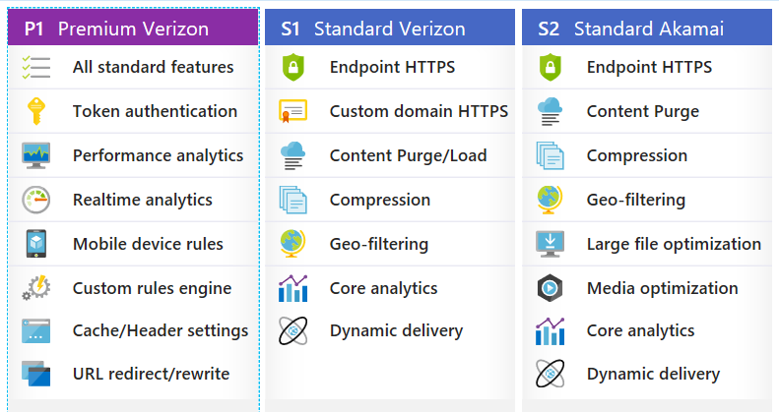
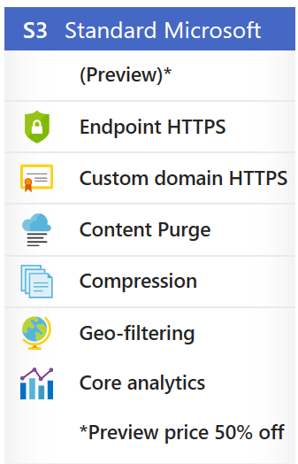
Azure CDN offers
Customer Self-service via the Azure CDN portal
Standard
Premium
For any web content, downloads or apps delivered over http and https; covers most CDN needs
For web content or apps needing more granular control and advanced analytics
Notes:
References:
Compare Azure CDN product features
https://docs.microsoft.com/en-us/azure/cdn/cdn-features

Slide 29
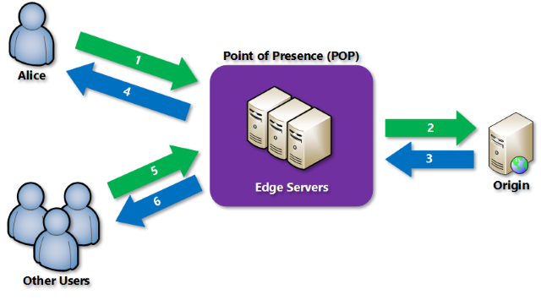
How it works
Notes:
How it works
A user (Alice) requests a file (also called an asset) by using a URL with a special domain name, such as <endpoint name>.azureedge.net. This name can be an endpoint hostname or a custom domain. The DNS routes the request to the best performing POP location, which is usually the POP that is geographically closest to the user.
If no edge servers in the POP have the file in their cache, the POP requests the file from the origin server. The origin server can be an Azure Web App, Azure Cloud Service, Azure Storage account, or any publicly accessible web server.
The origin server returns the file to an edge server in the POP.
An edge server in the POP caches the file and returns the file to the original requestor (Alice). The file remains cached on the edge server in the POP until the time-to-live (TTL) specified by its HTTP headers expires. If the origin server didn't specify a TTL, the default TTL is seven days.
Additional users can then request the same file by using the same URL that Alice used, and can also be directed to the same POP.
If the TTL for the file hasn't expired, the POP edge server returns the file directly from the cache. This process results in a faster, more responsive user experience.
References:
How it works
https://docs.microsoft.com/en-us/azure/cdn/cdn-overview#how-it-works

Slide 30

Caching with a CDN
Customer Origin Server
CDN Edge Network
HTTP Client
First request
Next requests
Notes:
Introduction to caching
Caching is the process of storing data locally so that future requests for that data can be accessed more quickly. In the most common type of caching, web browser caching, a web browser stores copies of static data locally on a local hard drive. By using caching, the web browser can avoid making multiple round-trips to the server and instead access the same data locally, thus saving time and resources. Caching is well-suited for locally managing small, static data such as static images, CSS files, and JavaScript files.
Similarly, caching is used by a content delivery network on edge servers close to the user to avoid requests traveling back to the origin and reducing end-user latency. Unlike a web browser cache, which is used only for a single user, the CDN has a shared cache. In a CDN shared cache, a file that is requested by one user can be accessed later by other users, which greatly decreases the number of requests to the origin server.
Dynamic resources that change frequently or are unique to an individual user cannot be cached. Those types of resources, however, can take advantage of dynamic site acceleration (DSA) optimization on the Azure Content Delivery Network for performance improvements.
Caching can occur at multiple levels between the origin server and the end user:
Web server: Uses a shared cache (for multiple users).
Content delivery network: Uses a shared cache (for multiple users).
Internet service provider (ISP): Uses a shared cache (for multiple users).
Web browser: Uses a private cache (for one user).
Each cache typically manages its own resource freshness and performs validation when a file is stale. This behavior is defined in the HTTP caching specification, RFC 7234.
References:
How caching works
https://docs.microsoft.com/en-us/azure/cdn/cdn-how-caching-works

Slide 31
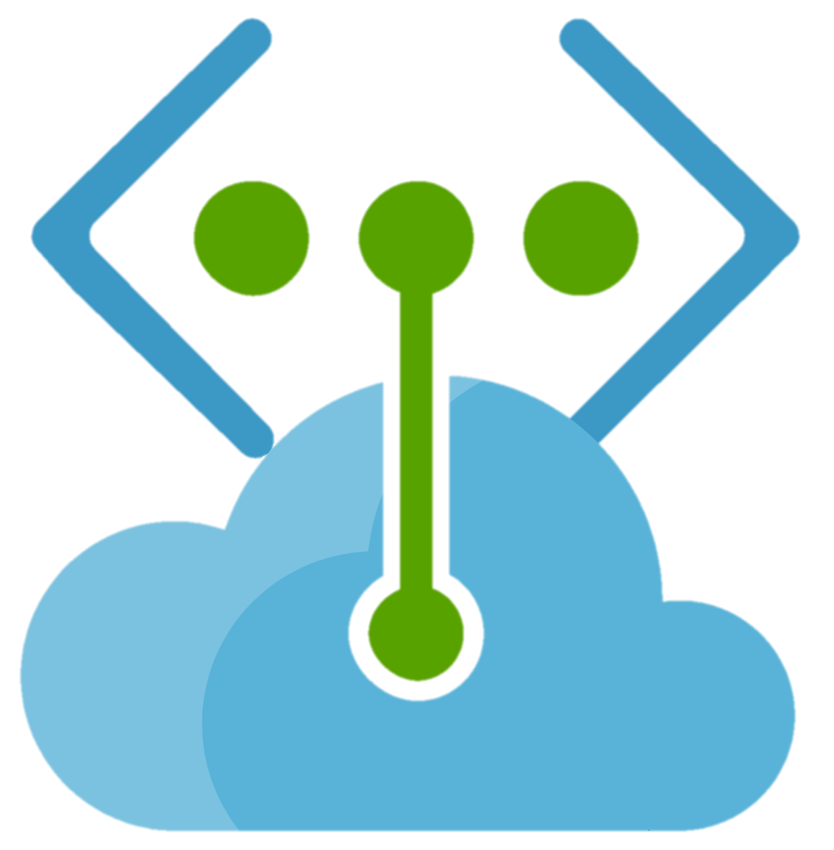
Protect | Service Endpoint
Extend and Secure your critical Azure service resources to only your Virtual Networks

Slide 32
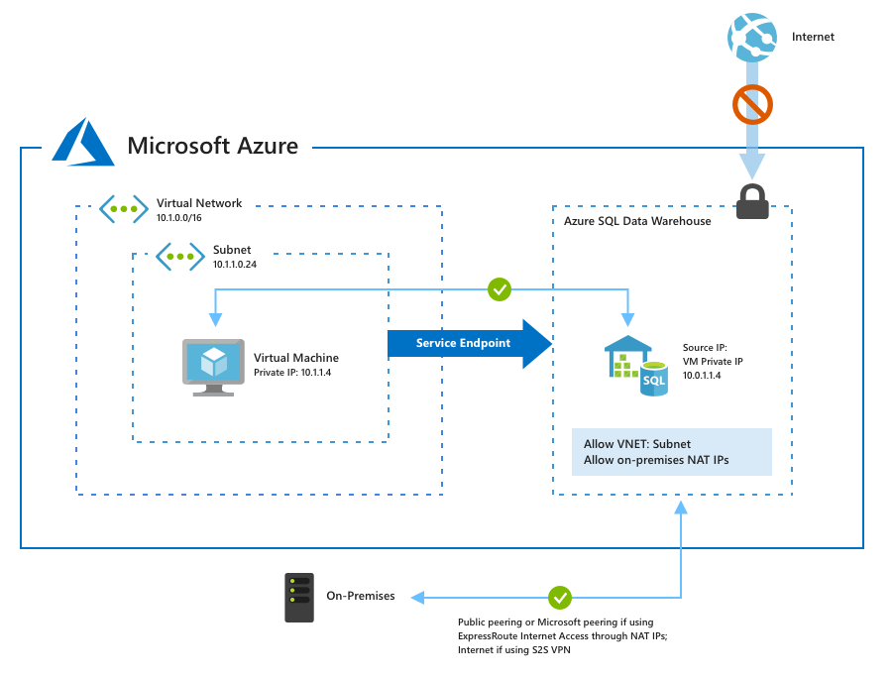
Service Endpoint
Securing PaaS Services
Azure SQL example:
Key Benefits
Improved security for your Azure service resources
Optimal routing for Azure service traffic from your virtual network
Simple to set up with less management overhead
Notes:
Virtual Network Service Endpoints overview:
Virtual Network (VNet) service endpoints extend your virtual network private address space and the identity of your VNet to the Azure services, over a direct connection. Endpoints allow you to secure your critical Azure service resources to only your virtual networks. Traffic from your VNet to the Azure service always remains on the Microsoft Azure backbone network.
This feature is available for the following Azure services and regions:
Generally available
Azure Storage: Generally available in all Azure regions.
Azure Synapse Analytics: Generally available in all Azure regions.
Azure SQL Data Warehouse: Generally available in all Azure regions.
Azure Database for PostgreSQL server: Generally available in Azure regions where database service is available.
Azure Database for MySQL server: Generally available in Azure regions where database service is available.
Azure Database for MariaDB: Generally available in Azure regions where database service is available.
Azure Cosmos DB: Generally available in all Azure regions.
Azure Key Vault: Generally available in all Azure regions.
Azure Service Bus: Generally available in all Azure regions.
Azure Event Hubs: Generally available in all Azure regions.
Azure Data Lake Store Gen 1: Generally available in all Azure regions where ADLS Gen1 is available.
Azure App Service: Generally available in all Azure regions where App service is available
Azure Cognitive Services: Generally available in all Azure regions where Cognitive services are available
Public Preview
Azure Container Registry: Preview available in all Azure regions where Azure Container Registry is available.
Key benefits
Service endpoints provide the following benefits:
Improved security for your Azure service resources: VNet private address space can be overlapping and so, cannot be used to uniquely identify traffic originating from your VNet. Service endpoints provide the ability to secure Azure service resources to your virtual network, by extending VNet identity to the service. Once service endpoints are enabled in your virtual network, you can secure Azure service resources to your virtual network by adding a virtual network rule to the resources. This provides improved security by fully removing public Internet access to resources, and allowing traffic only from your virtual network.
Optimal routing for Azure service traffic from your virtual network: Today, any routes in your virtual network that force Internet traffic to your premises and/or virtual appliances, known as forced-tunneling, also force Azure service traffic to take the same route as the Internet traffic. Service endpoints provide optimal routing for Azure traffic. Endpoints always take service traffic directly from your virtual network to the service on the Microsoft Azure backbone network. Keeping traffic on the Azure backbone network allows you to continue auditing and monitoring outbound Internet traffic from your virtual networks, through forced-tunneling, without impacting service traffic. Learn more about user-defined routes and forced-tunneling.
Simple to set up with less management overhead: You no longer need reserved, public IP addresses in your virtual networks to secure Azure resources through IP firewall. There are no NAT or gateway devices required to set up the service endpoints. Service endpoints are configured through a simple click on a subnet. There is no additional overhead to maintaining the endpoints.
References:
Virtual Network Service Endpoints overview:
https://docs.microsoft.com/en-us/azure/virtual-network/virtual-network-service-endpoints-overview

Slide 33


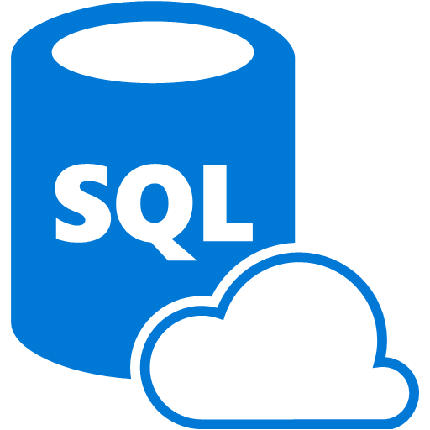
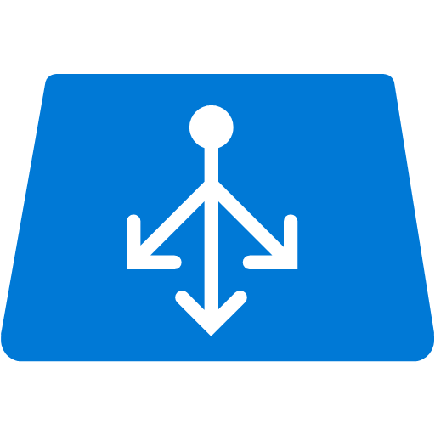
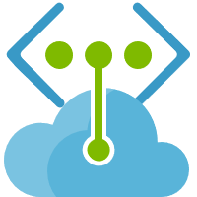
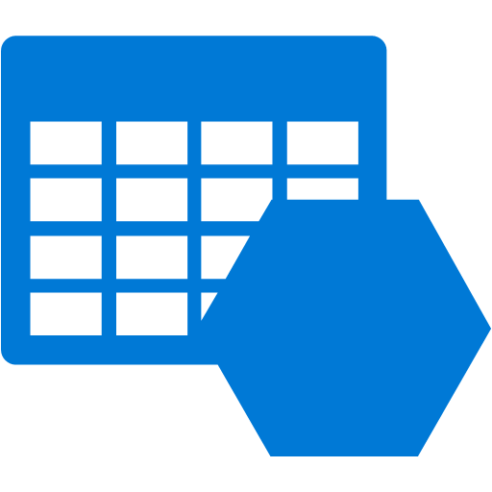

Service Endpoints
Internet
Internet
Securing PaaS Services
Generally Available:
Azure Storage
Azure SQL Database
Azure SQL Data Warehouse
Azure Database for PostgreSQL server
Azure Database for MySQL server
Azure Database for MariaDB
Azure Cosmos DB
Azure Key Vault
Azure Service Bus
Azure Event Hubs
Azure Data Lake Store Gen 1
Azure App Service
Azure Cognitive Services
Public Preview:
Azure Container Registry
VNet Service Endpoint
PaaS services
Compute - VNet

Slide 34


Protect/Connect | Private Link
Extend and Secure your critical Azure service resources to your Networks

Slide 35

Private Link Service
Render or Consume Services Privately on Azure
Your own Private Link Service
Create or Convert your existing services into Private Link Service
VNet-VNet Connectivity without worrying about overlapping IP Space
No regional, tenant, subscription or RBAC restrictions
Easily Scale and manage your service
Create Private Link Service
Application running behind Standard Load Balancer can be converted into Private Link service with one click of a button/one API call
Private Link Service tied to Frontend IP configuration of Standard Load Balancer
Frontend IP Configuration can be either Public or Private
Consume Private Link Service
Create a Private Endpoint in your VNet linking to Private Link Service.
Multiple consumers can connect to same service. No RBAC restrictions.
Render a Service
Persona: Service Provider
Resource: Private Link Service
Consume a Service
Persona: Service Consumer
Resource: Private Endpoint
Notes:
What is Azure Private Link? (Preview)
Azure Private Link enables you to access Azure PaaS Services (for example, Azure Storage, Azure Cosmos DB, and SQL Database) and Azure hosted customer/partner services over a Private Endpoint in your virtual network. Traffic between your virtual network and the service traverses over the Microsoft backbone network, eliminating exposure from the public Internet. You can also create your own Private Link Service in your virtual network (VNet) and deliver it privately to your customers. The setup and consumption experience using Azure Private Link is consistent across Azure PaaS, customer-owned, and shared partner services.
Key benefits
Azure Private Link provides the following benefits:
Privately access services on the Azure platform: Connect your virtual network to services running in Azure privately without needing a public IP address at the source or destination. Service providers can render their services privately in their own virtual network and consumers can access those services privately in their local virtual network. The Private Link platform will handle the connectivity between the consumer and services over the Azure backbone network.
On-premises and peered networks: Access services running in Azure from on-premises over ExpressRoute private peering/VPN tunnels (from on-premises) and peered virtual networks using private endpoints. There is no need to set up public peering or traverse the internet to reach the service. This ability provides a secure way to migrate workloads to Azure.
Protection against data exfiltration: With Azure Private Link, the private endpoint in the VNet is mapped to a specific instance of the customer's PaaS resource as opposed to the entire service. Using the private endpoint consumers can only connect to the specific resource and not to any other resource in the service. This in built mechanism provides protection against data exfiltration risks.
Global reach: Connect privately to services running in other regions. This means that the consumer's virtual network could be in region A and it can connect to services behind Private Link in region B.
Extend to your own services: Leverage the same experience and functionality to render your own service privately to your consumers in Azure. By placing your service behind a Standard Load Balancer you can enable it for Private Link. The consumer can then connect directly to your service using a Private Endpoint in their own VNet. You can manage these connection requests using a simple approval call flow. Azure Private Link works for consumers and services belonging to different Active Directory tenants as well.
Reference:
https://docs.microsoft.com/en-us/azure/private-link/private-link-overview

Slide 36




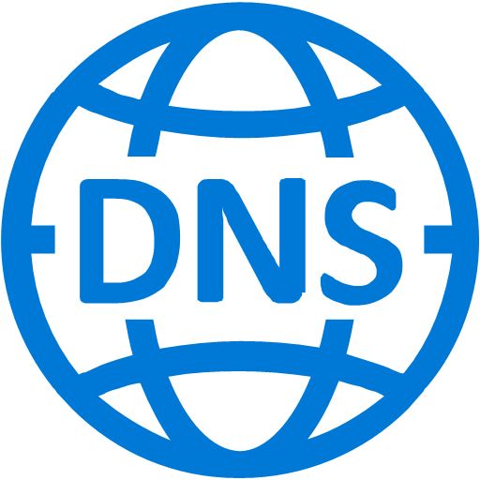
Approval Workflow
Service Consumer
Service Provider
1
Create your application behind a standard Load Balancer.
Standard ILB
Application VMs
Create a Private Link Service attached to SLB FE IP.
Subnet
2
Share the private link service ID (Alias/ARM URI) with consumers. You can either do it offline or advertise publicly.
<ServiceName>. <GUID>.
<region>.azure.privatelinkservice
3
4
Create a Private endpoint in any subnet by specifying a private Link service URI/Alias.
5
Configure your DNS record for easy access using the private IP address (CA).
A request will be sent to provider for approval
Act on the request – Accept/Reject It.
6
7
Connection Succeeded/Rejected.
Decision sent to consumer

Slide 37



Complete Picture
Service Consumer
Service Provider
Deny Internet
Deny Internet
10.0.1.5
Private Link
Microsoft Network
VMs
Private Endpoint
Standard Load Balancer
Application VMs
Private Link Service
Subnet (10.0.1.0/24)
Subnet (10.0.1.0/24)
Virtual Network (10.0.0.0/16)
Virtual Network (10.0.0.0/16)

Slide 38












Private PaaS
SERVICE ENDPOINT
PRIVATE LINK – PRIVATE ENDPOINT
Internet
Internet
Azure PaaS
PRIVATE
Azure PaaS
Rule | Destination | Access
stg | STORAGE | Allow
vnet | VNET | Allow
internet | INTERNET | Deny
Rule | Destination | Access
vnet | VNET | Allow
internet | INTERNET | Deny
Virtual Network (10.0.0.0/16)
Virtual Network (10.0.0.0/16)
VNet to PaaS service via the Microsoft backbone
Destination is still a public IP address. NSG opened to Service Tags
Need to pass NVA/Firewall for exfiltration protection
VNet PaaS via the Microsoft backbone
PaaS resource mapped to Private IP Address. NSGs restricted to VNet space
In-built data exfiltration protection

Slide 39

Data Exfiltration Protection
Deny Internet
Un-Mapped Storage Accounts
Private Endpoint maps specific PaaS resource to an IP address, not the entire service
Access only to mapped PaaS resource
Data exfiltration protection is in-built
10.0.0.4
Private Endpoint
Mapped Storage Account
Private Link

Slide 40





Secure connectivity from On-Premises
Good
Better
Best
Internet
Internet
Internet
ExpressRoute
ExpressRoute MS Peering
ExpressRoute MS Peering
ExpressRoute
Private Link
ExpressRoute Private Peering
ExpressRoute Private Peering
PUBLIC IP ACL
PUBLIC IP ACL
On-Premises
Storage
SQL
On-Premises
Storage
SQL
On-Premises
Storage
SQL
Traffic traverses the Internet
Secured using ACLs on Public Ips
Corporate firewall open to Azure Public IPs
Traffic stays within Microsoft and partner network
MS Peering draws Microsoft Public IP traffic
Corporate Firewall open to Azure Public IPs
Traffic is fully private traversing the Microsoft network
No exposure of public IPs on either side
Corporate Firewall open only to private

Slide 41



Azure Private Link
Highly secure and private connectivity to Azure services
Azure PaaS and marketplace services
Deny Internet
Private Link
10.0.0.5
ER Private Peering
ER Gateway
On-Premises
Private endpoint
Storage
SQL
SQL DW
Marketplace
Virtual Network (10.0.0.0/16)
Private Link for Azure Storage, SQL DB and customer own service
Private access from Virtual Network resources, peered networks and on-premise networks
In-built Data Exfiltration Protection
Predictable private IP addresses for PaaS resources
Unified experience across PaaS, Customer Owned and marketplace Services

Slide 42
Thank you!

